Slide 1
CLUSTERING OF COUNTRIES
BY- SWAGAT SAHOO

Slide 2
Abstract:
Objective: We, HELP International humanitarian NGO, committed to fight poverty and provide the people of backward countries with basic amenities and relief during the time of disasters and natural calamities. We run a lot of operational projects from time to time, along with advocacy, drives to raise awareness as well as for funding purposes.
Problem statement: During the recent funding programs, we have been able to raise around $ 10 million. As an analyst, we have to come up with the countries list that are in the direst need of aid.

Slide 3
Analysis methodology:
Data collection and cleaning
Import the data
Identifying the data quality issues and clean the data
Outlier analysis and removal
Removing the outlier where ever required as per understanding the problem statement.
Visualizing the data
Visualizing few original data variables to look for any pattern or correlation.
K means clustering
Identify the ‘k’ by silhouette analysis and sum of squared distances graph.
Forming n – clusters on scaled data
Visualizing the clusters with various variables
Analyzing the clusters
Identifying the countries which requires aid.
Hopkins Statistics
To check if data has tendency to form clusters
Scaling the data
Standardizing all the continuous variables.

Slide 4
Analysis methodology:
Hierarchical Clustering
Identify the ‘n’ via dendrogram.
Forming n – clusters on scaled data.
Visualizing the clusters with various variables.
Analysing the clusters.
Identifying the countries which requires aid.
Decision Making
Identifying the countries which requires aid by analyzing both K-means and Hierarchical Clustering results.

Slide 5
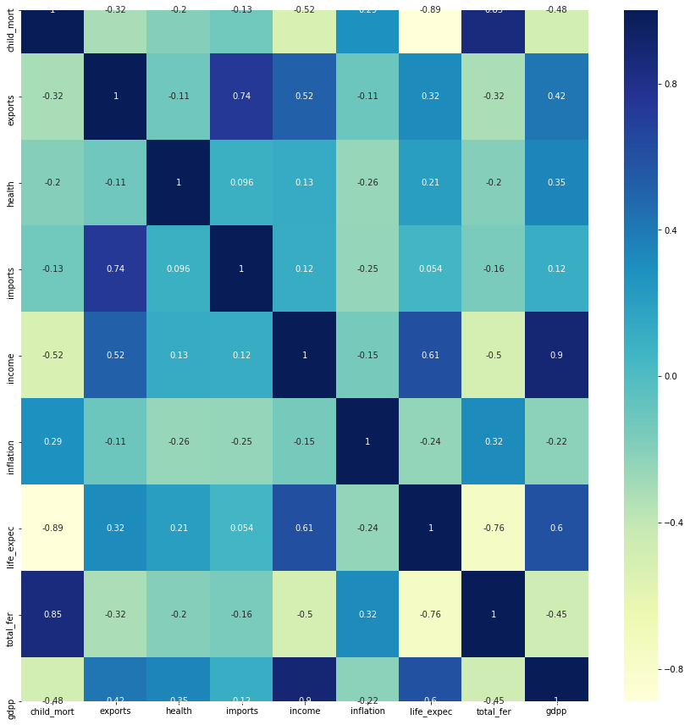
CORRELATION IN THE DATA
After data cleaning , we chose to do nothing to the outliers.
We did standardized scaling to standardize all parameters on cleaned data.
Looking at the heat map, we see that few variables like (total fertility, child mortality) , (income , gdpp) and (imports and exports) have high correlation.

Slide 6
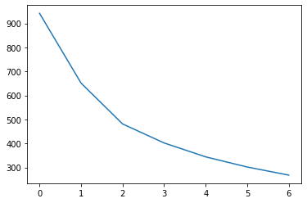
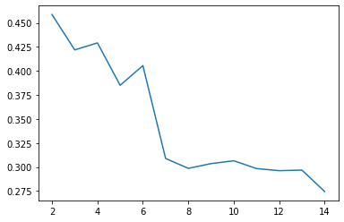
K-MEANS CLUSTERING
Sum of Squared Distances
Silhouette Analysis
By looking at the Elbow curve and silhouette score we chose to go with k=3.

Slide 7
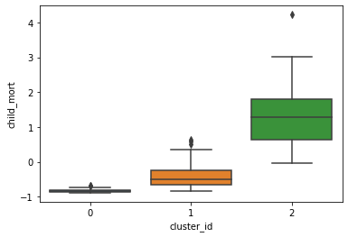
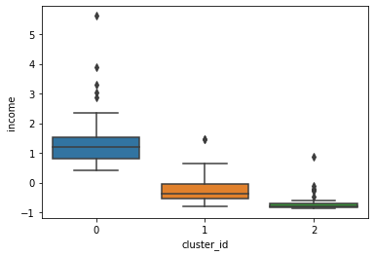
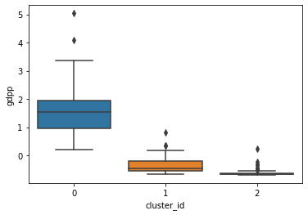
K-MEANS CLUSTERING:
Child_mort Income gdpp
From the above three boxplots we can observe that Cluster-2 has :
- High child mortality
- Low income
- Low gdpp

Slide 8
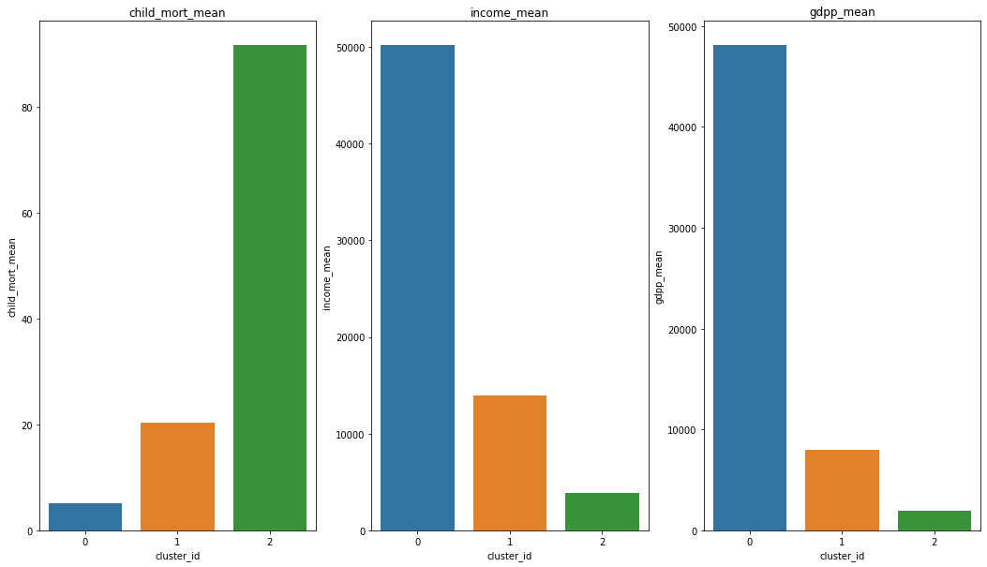
K-means clustering :
From the bar plot we can visualize that cluster-2 is our area of concern.

Slide 9
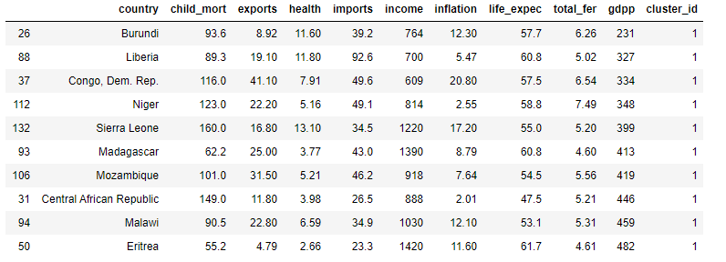
K-means clustering :
10 countries under cluster-2 are:

Slide 10
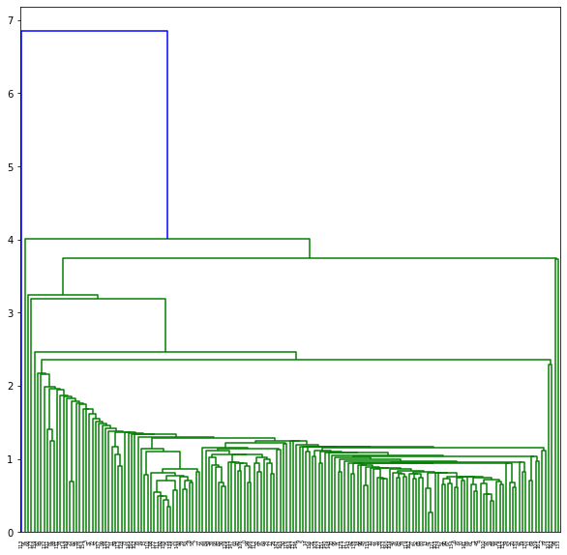
Hierarchical Clustering:
Single method hierarchical Clustering

Slide 11
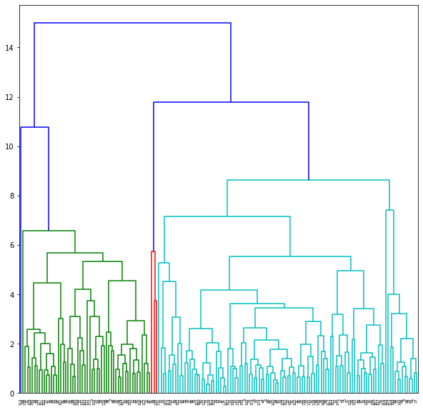
Hierarchical Clustering:
As the Single method hierarchical Clustering was not so clear so we went for complete method hierarchical clustering.
By looking at this dendogram taking n-clusters as 4.

Slide 12
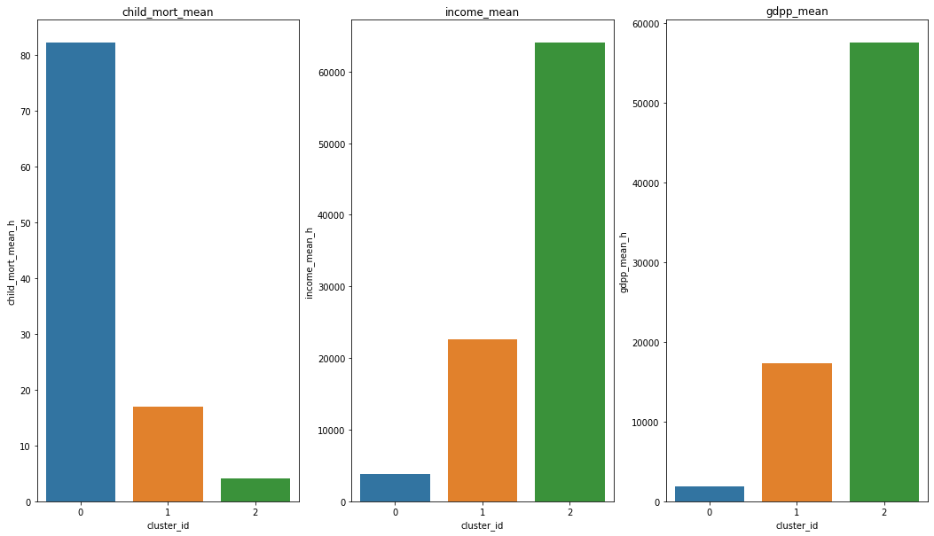
Hierarchical Clustering:
From the bar plot of hierarchical clustering we can see that cluster-0 is our main focus area ,because it has
High child mortality
Low income
Low gdpp

Slide 13
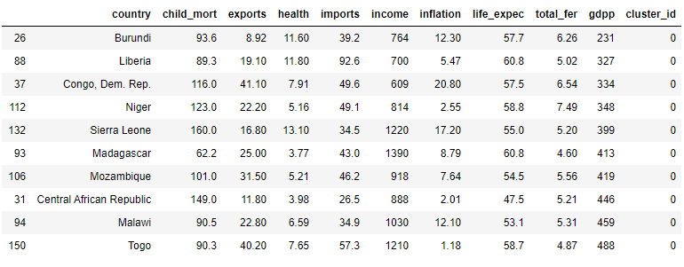
Hierarchical Clustering:
Top 10 countries under cluster-0 are:

Slide 14
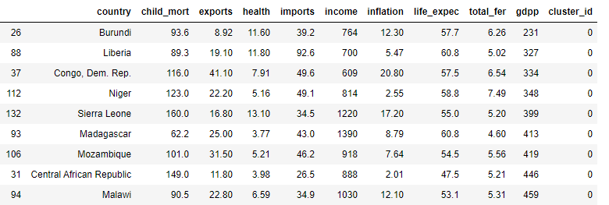
Summary:
As by both K means and Hierarchical clustering method - we have got almost same countries which requires aid. The following are the countries which are in direst need of aid by considering socio – economic factor into consideration:

